Slide 1
Introduction to Transaction Processing Concepts and Theory

Slide 2
1 Introduction to Transaction Processing
Single-User System: At most one user at a time can use the system.
Multiuser System: Many users can access the system concurrently.
Concurrency
  Interleaved processing: concurrent execution of processes is interleaved in a single CPU
  Parallel processing: processes are concurrently executed in multiple CPUs.

Slide 3
Introduction to Transaction Processing
A Transaction: logical unit of database processing that includes one or more access operations (read -retrieval, write - insert or update, delete).
Transaction boundaries: Begin and End transaction.
An application program may contain several transactions separated by the Begin and End transaction boundaries.

Slide 4
Basic database access operations that a transaction can include are read and write
  read_item(X): Reads a database item named X into a program variable. To simplify our notation, we assume that the program variable is also named X.
  write_item(X): Writes the value of program variable X into the database item named X.

Slide 5
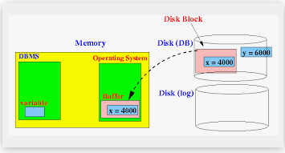
READ AND WRITE OPERATIONS:
read_item(X) command includes the following steps:
Find the address of the disk block that contains item X.
Copy that disk block into a buffer in main memory (if that disk block is not already in some main memory buffer).
Copy item X from the buffer to the program variable named X.

Slide 6
write_item(X) command includes the following steps:
Find the address of the disk block that contains item X.
Copy that disk block into a buffer in main memory (if that disk block is not already in some main memory buffer).
Copy item X from the program variable named X into its correct location in the buffer.
Store the updated block from the buffer back to disk (either immediately or at some later point in time).

Slide 7

Two sample transactions. (a) Transaction T₁.
(b) Transaction T₂.
Chapter 17-<number>

Slide 8
Why Concurrency Control is needed:
The Lost Update Problem.
This occurs when two transactions that access the same database items have their operations interleaved in a way that makes the value of some database item incorrect.

Slide 9
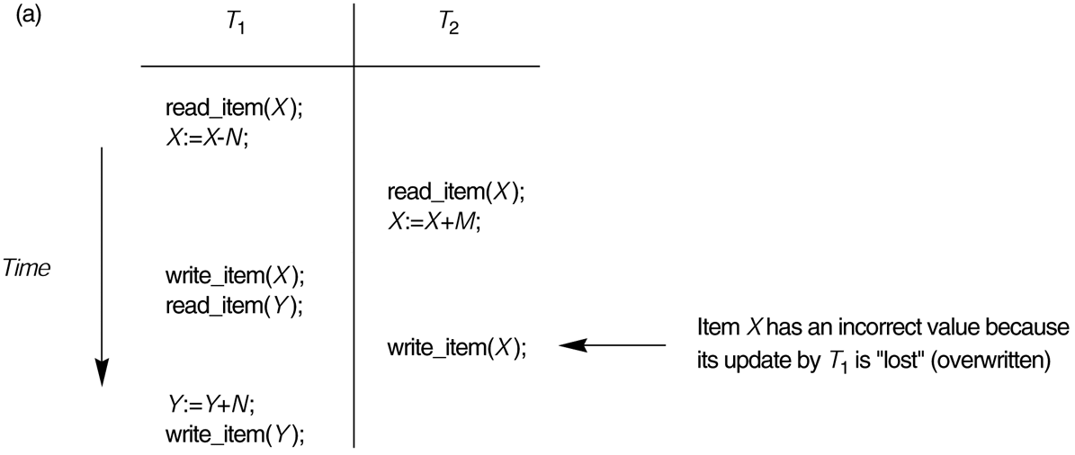
Some problems that occur when concurrent execution is uncontrolled. (a) The lost update problem.
Chapter 17-<number>

Slide 10
Why Concurrency Control is needed:
The Temporary Update (or Dirty Read) Problem.
This occurs when one transaction updates a database item and then the transaction fails for some reason.The updated item is accessed by another transaction before it is changed back to its original value.

Slide 11
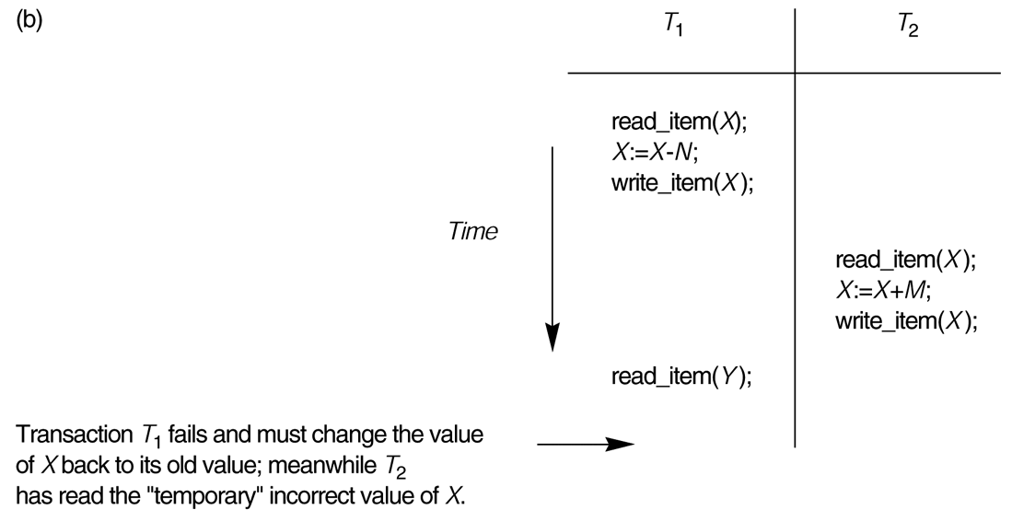
Some problems that occur when concurrent execution is uncontrolled. (b) The temporary update problem.
Chapter 17-<number>

Slide 12
Why Concurrency Control is needed (cont.):
The Incorrect Summary Problem .
If one transaction is calculating an aggregate summary function on a number of records while other transactions are updating some of these records, the aggregate function may calculate some values before they are updated and others after they are updated.

Slide 13
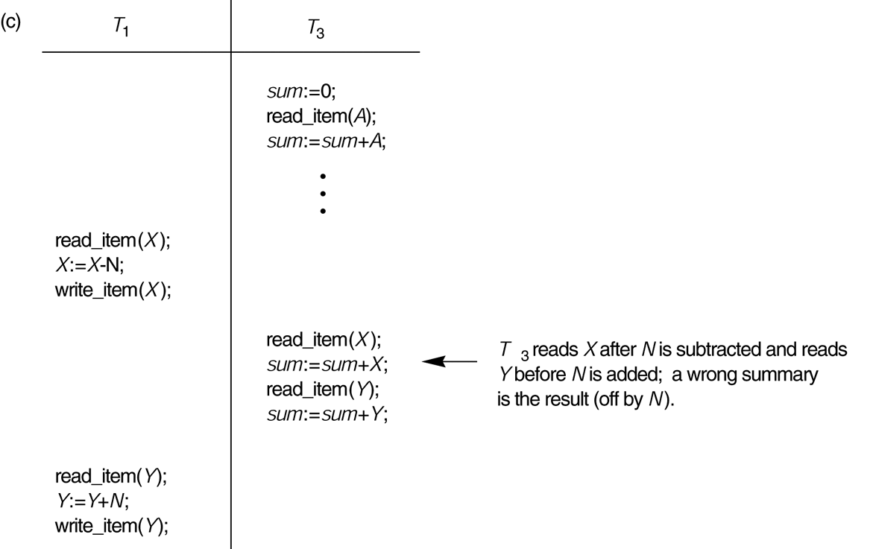
Some problems that occur when concurrent execution is uncontrolled. (c) The incorrect summary problem.
Chapter 17-<number>

Slide 14
Why recovery is needed:
(What causes a Transaction to fail)
1. A computer failure (system crash): A hardware or software error occurs in the computer system during transaction execution. If the hardware crashes, the contents of the computer’s internal memory may be lost.
2. A transaction or system error : Some operation in the transaction may cause it to fail, such as integer overflow or division by zero. Transaction failure may also occur because of erroneous parameter values or because of a logical programming error. In addition, the user may interrupt the transaction during its execution.

Slide 15
Why recovery is needed (cont.):
3. Local errors or exception conditions detected by the transaction:
- certain conditions necessitate cancellation of the transaction. For example, data for the transaction may not be found. A condition, such as insufficient account balance in a banking database, may cause a transaction, such as a fund withdrawal from that account, to be canceled.
- a programmed abort in the transaction causes it to fail.
4. Concurrency control enforcement: The concurrency control method may decide to abort the transaction, to be restarted later, because it violates serializability or because several transactions are in a state of deadlock.

Slide 16
Why recovery is needed (cont.):
5. Disk failure: Some disk blocks may lose their data because of a read or write malfunction or because of a disk read/write head crash. This may happen during a read or a write operation of the transaction.
6. Physical problems and catastrophes: This refers to an endless list of problems that includes power or air-conditioning failure, fire, theft, sabotage, overwriting disks or tapes by mistake, and mounting of a wrong tape by the operator.

Slide 17
2 Transaction and System Concepts
A transaction is an atomic unit of work that is either completed in its entirety or not done at all. For recovery purposes, the system needs to keep track of when the transaction starts, terminates, and commits or aborts.
Transaction states:
Active state
Partially committed state
Committed state
Failed state
Terminated State
Chapter 17-<number>

Slide 18
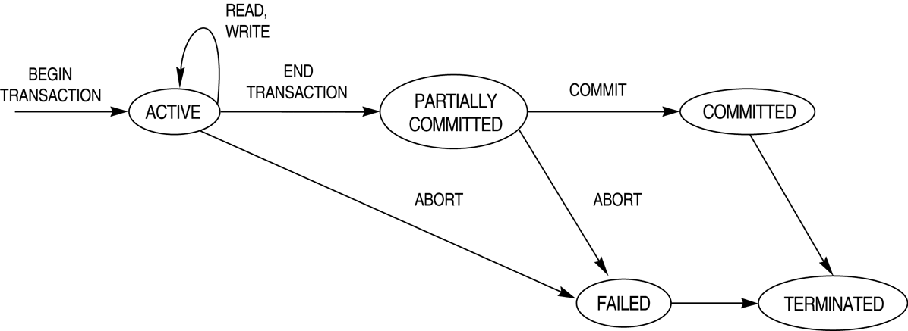
State transition diagram illustrating the states for transaction execution.

Slide 19
Recovery manager keeps track of the following operations:
begin_transaction: This marks the beginning of transaction execution.
read or write: These specify read or write operations on the database items that are executed as part of a transaction.
end_transaction: This specifies that read and write transaction operations have ended and marks the end limit of transaction execution. At this point it may be necessary to check whether the changes introduced by the transaction can be permanently applied to the database or whether the transaction has to be aborted because it violates concurrency control or for some other reason.

Slide 20
Recovery manager keeps track of the following operations (cont):
commit_transaction: This signals a successful end of the transaction so that any changes (updates) executed by the transaction can be safely committed to the database and will not be undone.
rollback (or abort): This signals that the transaction has ended unsuccessfully, so that any changes or effects that the transaction may have applied to the database must be undone.

Slide 21
The System Log
Log or Journal : The log keeps track of all transaction operations that affect the values of database items. This information may be needed to permit recovery from transaction failures. The log is kept on disk, so it is not affected by any type of failure except for disk or catastrophic failure.
T in the following discussion refers to a unique transaction-id that is generated automatically by the system and is used to identify each transaction.

Slide 22
The System Log (cont):
Types of log record:
[start_transaction,T]: Records that transaction T has started execution.
[write_item,T,X,old_value,new_value]: Records that transaction T has changed the value of database item X from old_value to new_value.
[read_item,T,X]: Records that transaction T has read the value of database item X.
[commit,T]: Records that transaction T has completed successfully, and affirms that its effect can be committed (recorded permanently) to the database.
[abort,T]: Records that transaction T has been aborted.

Slide 23
3 Desirable Properties of Transactions
ACID properties:
Atomicity: A transaction is an atomic unit of processing; it is either performed in its entirety or not performed at all.
Consistency preservation: A correct execution of the transaction must take the database from one consistent state to another.

Slide 24
Desirable Properties of Transactions
ACID properties (cont.):
Isolation: A transaction should not make its updates visible to other transactions until it is committed; this property, when enforced strictly, solves the temporary update problem and makes cascading rollbacks of transactions unnecessary.
Durability or permanency: Once a transaction changes the database and the changes are committed, these changes must never be lost because of subsequent failure.

Slide 25
4 Schedules
Transaction schedule or history: When transactions are executing concurrently in an interleaved fashion, the order of execution of operations from the various transactions is known as a transaction schedule (or history).
Consider 2 users , they are accessing the database ,one user submits transaction T1,second user submits transaction T2
  T1 T2
  Read(A) Read(A)
  A=A+100 A=A+100
  Write(A) Write(A)
  Read(B)
  B=B-100
  Write(B)
Chapter 17-<number>

Slide 26
Suppose the operations from T1 and T2 are executed on the following order
      T1 T2
      Read(A)
      Read(A)
      A=A+100
      A=A*4
      Write(A)
      Read(B)
      Write(A)
      Commit
      B=B-100
      Write(B)
      Commit
      The above is an execution order. The above called a schedule.
      Sequence of execution as:
      Sa: r2(A),r1(A),w1(A),r1(B),w2(A),c2,w1(B),c1

Slide 27
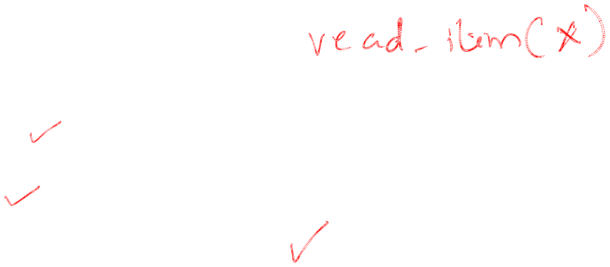
Conflicting Operations in a schedule
Two operations in a schedule are said to conflict if they satisfy all the following 3 conditions:
They belong to different transactions
They access the same database item
Atleast one of the operation is a write() operation.
Consider the schedule Sb consisting of transaction T1 and T2.

Slide 28
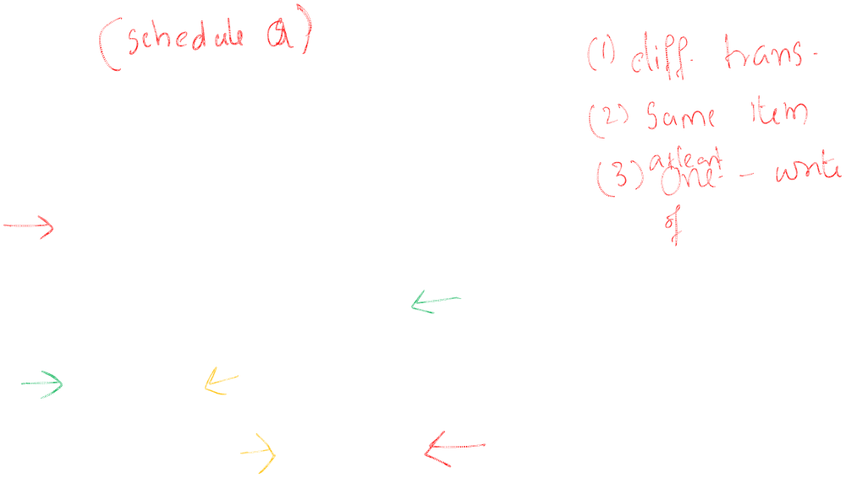
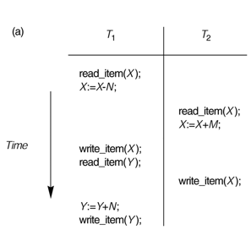
Sa
There are 3 sets of conflicting operations in the above schedule Sa
r1(X) and w2(X)
r2(X) and w1(X)
W1(X) and w2(X)

Slide 29
Schedules classified on recoverability:
Recoverable schedule:
A schedule S is recoverable if no transaction T in S commits until all transactions T’ that have written an item that T reads have committed.
Those schedules that do not satisfy the criteria are called non recoverable.

Slide 30
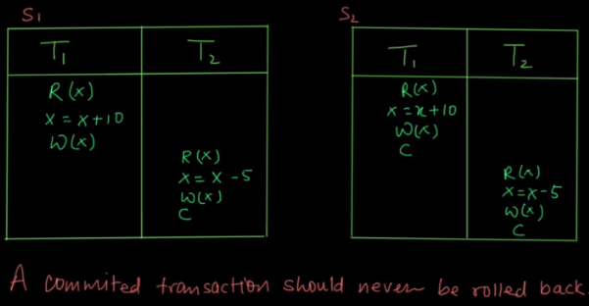
S1 schedule: Assume t1 fails after t2 commits. As t1 fails and havn’t committed it can rollback( back to original value). But as t2 already committed we cannot rollback and hence the value read by t2 may or may not be correct. Hence S1 is not recoverable

Slide 31
.
Schedules requiring cascaded rollback: A schedule in which uncommitted transactions that read an item from a failed transaction must be rolled back. This phenomenon is called cascading rollback (or cascading abort)
Consider the schedule Sb:
T1 T2
read(A)
write(A)
read(A)
read(B)
write(A)
write(B)
abort
abort

Slide 32
Cascadeless schedule: If every transaction in the schedule reads only the items that are written by committed transactions
T1 T2
read(A)
write(A)
read(B)
write(A)
write(B)
commit
read(A)
commit
Here T2 has written item A. Then T1 reads only after T2 commits.

Slide 33
Strict schedule
In this ,transaction can neither read nor write an item A until the last transaction that wrote A has committed(or aborted).example:
Consider a schedule Sb:
T1 T2
read(A)
read(B)
write(A)
write(B)
commit
read(A)
write(A)

Slide 34
5 Characterizing Schedules based on Serializability
Serial schedule: A schedule S is serial if, for every transaction T participating in the schedule, all the operations of T are executed consecutively in the schedule. Otherwise, the schedule is called nonserial schedule.
Consider 2 transactions T1 and T2
Chapter 17-<number>

Slide 35
When T1 and T2 are submitted to the system, the system execute the operations in the following order:
Sa:
T1 T2
read(A)
A=A-500
write(A)
read(B)
B=B+500
Write(B)
read(A)
A=A*3
write(A)

Slide 36
Another possible schedule is:
Sb:
T1 T2
read(A)
A=A*3
write(A)
read(A)
A=A-500
write(A)
read(B)
B=B+500
Write(B)
Here the schedules Sa and Sb are called serial schedules.

Slide 37
Serializable schedule
Serializable schedule have two characteristics
They are non-serial schedules, which allow concurrent executions of different transactions
They still produce correct results
Consider the example schedule Sd(next slide) and Sa(previous slides):

Slide 38
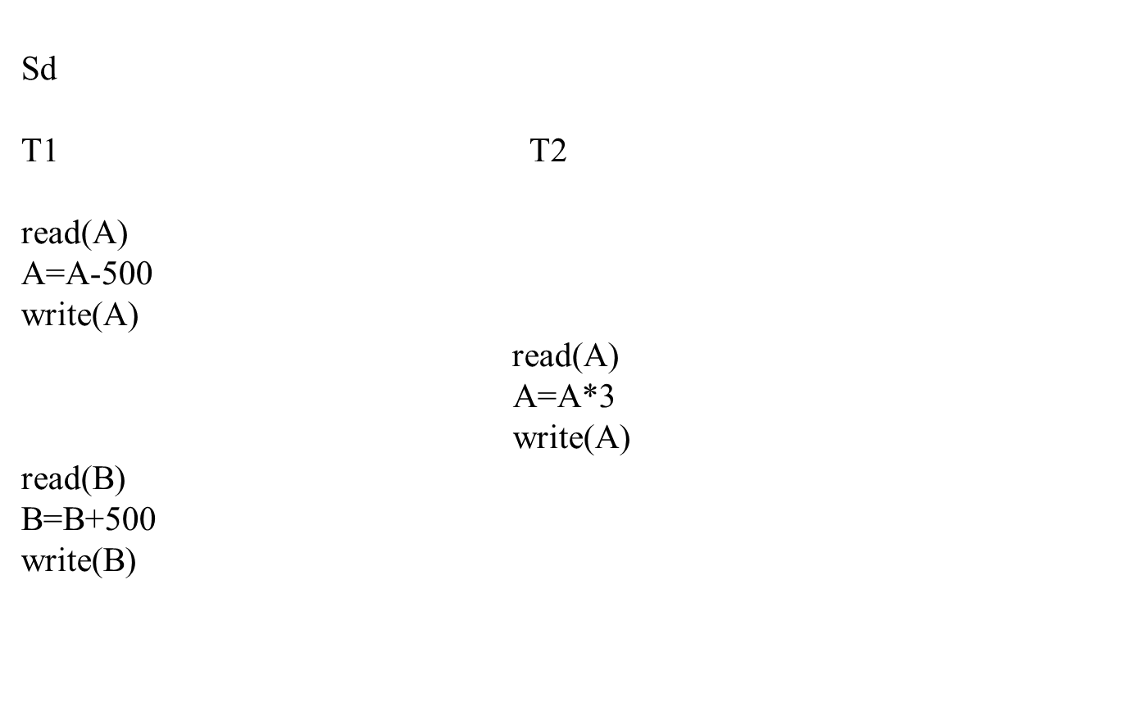

Slide 39
Consider an example:
      A 2500
      B 3000
      After the execution of schedule:
      A=6000
      B=3500
    The above schedule is equivalent to serial schedule T1 followed by T2.

Slide 40
Result equivalent: Two schedules are called result equivalent if they produce the same final state of the database.
Condider an example:
sa
T1 T2
Read(A)
A=A-500
Write(A)
read(A)
A=A+100
Read(B)
write(A)
B=B+500
Write(B)
read(B)

Slide 41
Consider another schedule Sb:
T1 T2
read(A)
A=A+100
write(A)
Read(A)
A=A-500
Write(A)
Read(B)
B=B+500
Write(B)
read(B)

Slide 42
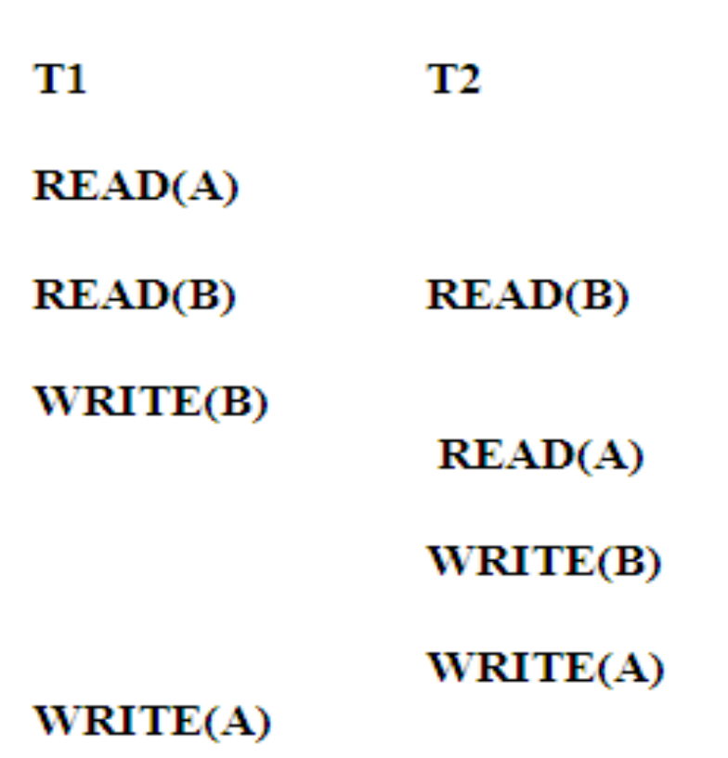
CONFLICT EQUIVALENT SCHEDULE
Two schedules are said to be conflict equivalent if the order of any 2 conflicting operations is same in both schedules
T1 T2
READ(A)
READ(B)
READ(B)
READ(A)
WRITE(B)
WRITE(B)
WRITE(A)
WRITE(A)

Slide 43
Testing for conflict serializability
Algorithm :
Looks at only read_Item (X) and write_Item (X) operations
Constructs a precedence graph (serialization graph) - a graph with directed edges .
For each transaction Ti participating in schedule S, create a node labeled Ti in precedence graph.
For each case in S where Tj executes a read_Item (X) after executes Ti a write_item(X),create an edge (Ti-> Tj) in the precedence graph.
For each case in S where Tj executes a write_item(X) after executes Ti a read_Item (X),create an edge (Ti-> Tj) in the precedence graph.

Slide 44
For each case in S where Tj executes a write_item(X) after executes Ti a write_item(X),create an edge (Ti-> Tj) in the precedence graph.
The schedule S is serializable if and only if the precedence graph has no cycles.
Uses of serilizability:
A serializable schedule gives up the benefits of concurrent execution without giving up any correctness.

Slide 45
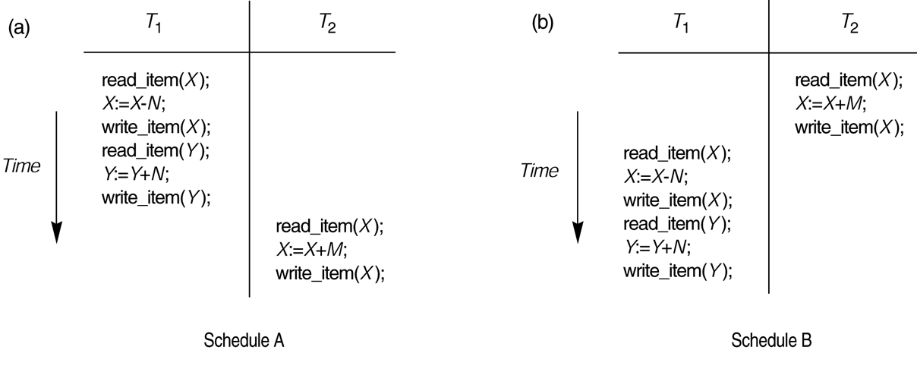
Examples of serial and nonserial schedules involving transactions T₁ and T₂. (a) Serial schedule A: T₁ followed by T₂. (b) Serial schedules B: T₂ followed by T₁.

Slide 46
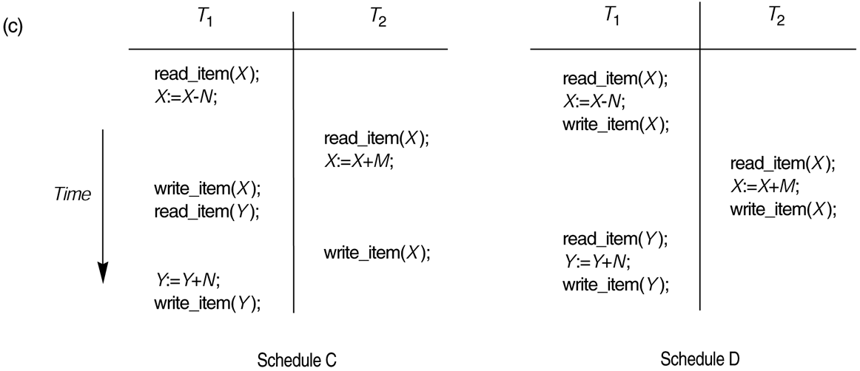
Examples of serial and nonserial schedules involving transactions T₁ and T₂. (c) Two nonserial schedules C and D with interleaving of operations.

Slide 47
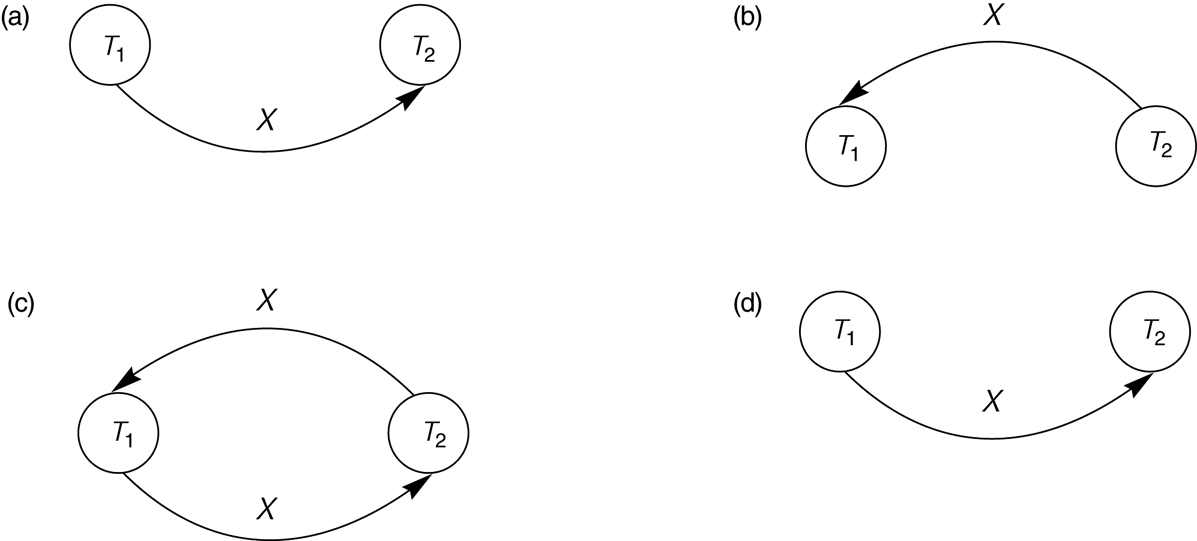
Constructing the precedence graphs for schedules A and D from the above Figure to test for conflict serializability. (a) Precedence graph for serial schedule A. (b) Precedence graph for serial schedule B. (c) Precedence graph for schedule C (not serializable). (d) Precedence graph for schedule D (serializable, equivalent to schedule A).

Slide 48
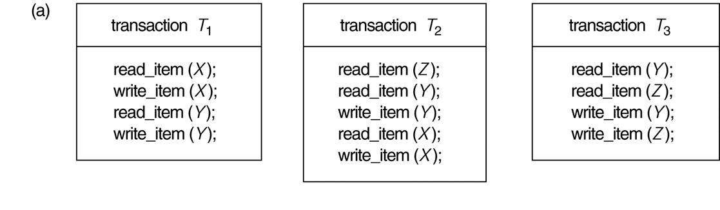
Another example of serializability testing. (a) The READ and WRITE operations of three transactions T₁, T₂, and T₃.

Slide 49
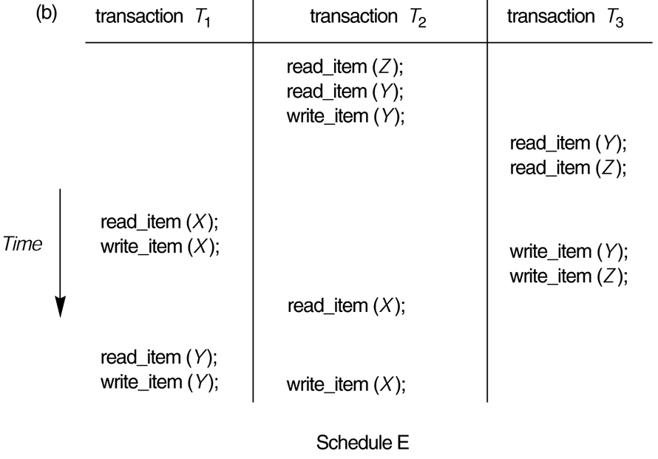
Another example of serializability testing. (b) Schedule E.

Slide 50
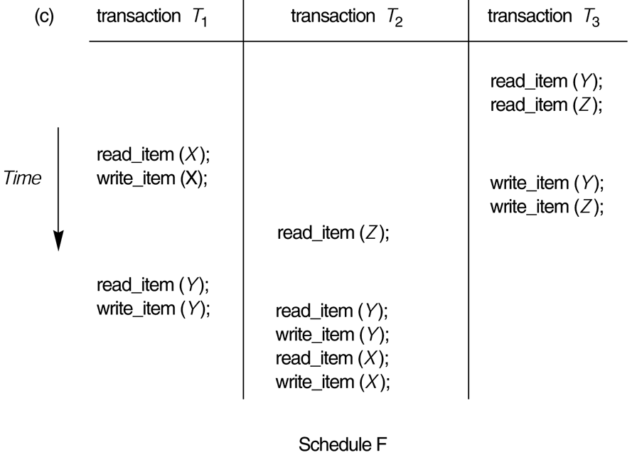
Another example of serializability testing. (c) Schedule F.

Slide 51
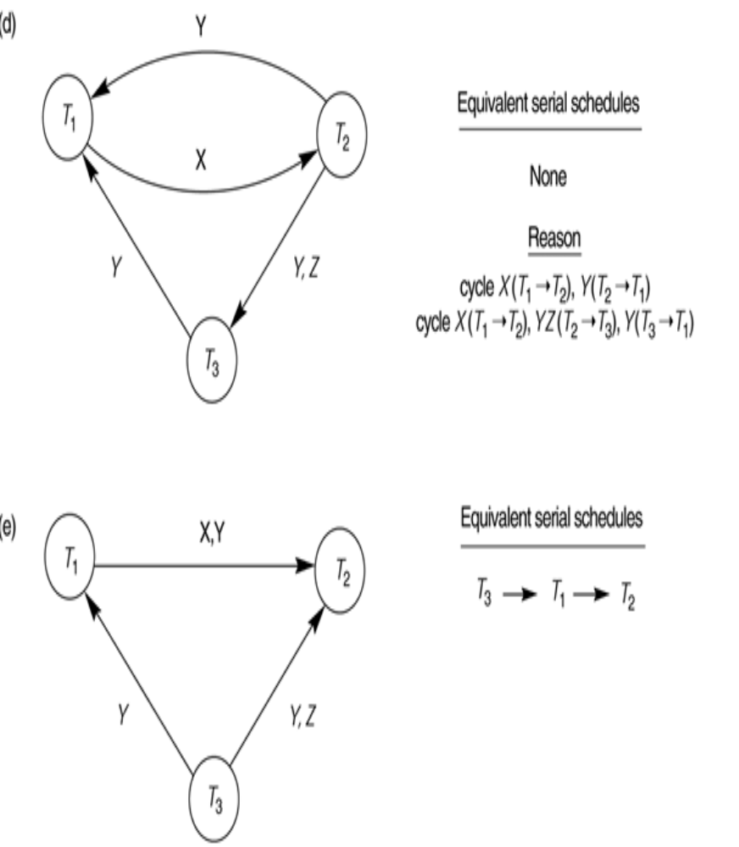
Another example of serializability testing.
(d) Precedence graph for schedule E.
(e) Precedence graph for schedule F.

Slide 52
View equivalence
Two schedules are said to be view equivalent if the following three conditions hold:
The same set of transactions participates in S and S’, and S and S’ include the same operations of those transactions.
For any operation Ri(X) of Ti in S, if the value of X read by the operation has been written by an operation Wj(X) of Tj (or if it is the original value of X before the schedule started), the same condition must hold for the value of X read by operation Ri(X) of Ti in S’.
If the operation Wk(Y) of Tk is the last operation to write item Y in S, then Wk(Y) of Tk must also be the last operation to write item Y in S’.

Slide 53
Ex:Consider two schedules S and S’:
S S’
T1 T2 T1 T2
r(x) r(x)
x=x-10 x=x-10
w(X) r(y)
r(y) w(x)
r(x) r(x)
x=x+10 x=x+10
w(y) w(y)
r(y) r(y)
y=y+50 w(x)
w(y) y=y+50
w(x) w(y)

Slide 54
View serializable:
A schedule S is said to be View serializable if it is view equivalent to a serial schedule.
Conflict serilizable :
A schedule S is said to be conflict serializable if it is conflict equivalent to a serial schedule.

Slide 55
RECOVERY SYSTEM
Log-based recovery, Deferred database modification, check-pointing.

Slide 56
Recovery and Atomicity
To ensure atomicity despite failures, we first output information describing the modifications to stable storage without modifying the database itself.
We study log-based recovery mechanisms in detail
  We first present key concepts
  And then present the actual recovery algorithm
Less used alternative: shadow-paging (brief details presented in the book).
We initially assume serial execution of transactions.

Slide 57
Log-Based Recovery
A log is kept on stable storage.
  The log is a sequence of log records, which maintains information about update activities on the database.
When transaction T_{i} starts, it registers itself by writing a record
<T_{i} start>
to the log
Before T_{i} executes write(X), a log record
<T_{i}, X, V₁, V₂>
is written, where V₁ is the value of X before the write (the old value), and V₂ is the value to be written to X (the new value).
When T_{i} finishes it last statement, the log record <T_{i} commit> is written.
Two approaches using logs
  Immediate database modification
  Deferred database modification

Slide 58
Database Modification
The immediate-modification scheme allows updates of an uncommitted transaction to be made to the buffer, or the disk itself, before the transaction commits
The immediate database modification technique allows database modification to be output to the database while the transaction is still in the active state. The data modification written by active transactions are called “uncommitted modification”.
If the system crash or transaction aborts, then the old value field of the log records is used to restore the modified data items to the value they had prior to the start of the transactionOutput of updated blocks to disk storage can take place at any time before or after transaction commit

Slide 59
The deferred-modification scheme performs updates to buffer/disk only at the time of transaction commit
  Simplifies some aspects of recovery
  But has overhead of storing local copy
We cover here only the immediate-modification scheme

Slide 60
Transaction Commit
A transaction is said to have committed when its commit log record is output to stable storage
  All previous log records of the transaction must have been output already
Writes performed by a transaction may still be in the buffer when the transaction commits, and may be output later

Slide 61
Immediate Database Modification Example
Log Write Output
<T₀ start>
<T₀, A, 1000, 950>
<T_{o}, B, 2000, 2050>
A = 950
B = 2050
<T₀ commit>
<T₁ start>
<T₁, C, 700, 600>
C = 600
B_{B} , B_{C}
<T₁ commit>
B_{A}
Note: B_{X} denotes block containing X.
B_{C} output before T₁ commits
B_{A} output after T₀ commits

Slide 62
Undo and Redo Operations
Undo of a log record <T_{i}, X, V₁, V₂> writes the old value V₁ to X
Redo of a log record <T_{i}, X, V₁, V₂> writes the new value V₂ to X
Undo and Redo of Transactions
  undo(T_{i}) restores the value of all data items updated by T_{i} to their old values, going backwards from the last log record for T_{i}
    Each time a data item X is restored to its old value V a special log record (called redo-only) <T_{i} , X, V> is written out
    When undo of a transaction is complete, a log record
    <T_{i} abort> is written out (to indicate that the undo was completed)
  redo(T_{i}) sets the value of all data items updated by T_{i} to the new values, going forward from the first log record for T_{i}
    No logging is done in this case

Slide 63
Undo and Redo Operations (Cont.)
The undo and redo operations are used in several different circumstances:
  The undo is used for transaction rollback during normal operation(in case a transaction cannot complete its execution due to some logical error).
  The undo and redo operations are used during recovery from failure.
We need to deal with the case where during recovery from failure another failure occurs prior to the system having fully recovered.

Slide 64
Transaction rollback (during normal operation)
Let T_{i} be the transaction to be rolled back
Scan log backwards from the end, and for each log record of T_{i} of the form <T_{i}, X_{j}, V₁, V₂>
  Perform the undo by writing V₁ to X_{j},
  Write a log record <T_{i} , X_{j}, V₁>
    such log records are called compensation log records
Once the record <T_{i} start> is found stop the scan and write the log record <T_{i} abort>

Slide 65
Undo and Redo on Recovering from Failure
When recovering after failure:
  Transaction T_{i} needs to be undone if the log
    contains the record <T_{i} start>,
    but does not contain either the record <T_{i} commit> or <T_{i} abort>.
  Transaction T_{i} needs to be redone if the log
    contains the records <T_{i} start>
    and contains the record <T_{i} commit> or <T_{i} abort>
  It may seem strange to redo transaction T_{i} if the record <T_{i} abort> record is in the log. To see why this works, note that if <T_{i} abort> is in the log, so are the redo-only records written by the undo operation. Thus, the end result will be to undo T_{i} 's modifications in this case. This slight redundancy simplifies the recovery algorithm and enables faster overall recovery time.
    such a redo redoes all the original actions including the steps that restored old value. Known as repeating history

Slide 66

Immediate Modification Recovery Example
Below we show the log as it appears at three instances of time.
Recovery actions in each case above are:
(a) undo (T₀): B is restored to 2000 and A to 1000, and log records
<T₀, B, 2000>, <T₀, A, 1000>, <T₀, abort> are written out
(b) redo (T₀) and undo (T₁): A and B are set to 950 and 2050 and C is restored to 700. Log records <T₁, C, 700>, <T₁, abort> are written out.
(c) redo (T₀) and redo (T₁): A and B are set to 950 and 2050
respectively. Then C is set to 600

Slide 67
Checkpoints
Redoing/undoing all transactions recorded in the log can be very slow
  Processing the entire log is time-consuming if the system has run for a long time
  We might unnecessarily redo transactions which have already output their updates to the database.
Streamline recovery procedure by periodically performing checkpointing
  All updates are stopped while doing checkpointing
  Output all log records currently residing in main memory onto stable storage.
  Output all modified buffer blocks to the disk.
  Write a log record < checkpoint L> onto stable storage where L is a list of all transactions active at the time of checkpoint.

Slide 68
Checkpoints (Cont.)
During recovery we need to consider only the most recent transaction T_{i} that started before the checkpoint, and transactions that started after T_{i}.
  Scan backwards from end of log to find the most recent <checkpoint L> record
  Only transactions that are in L or started after the checkpoint need to be redone or undone
  Transactions that committed or aborted before the checkpoint already have all their updates output to stable storage.
Some earlier part of the log may be needed for undo operations
  Continue scanning backwards till a record <T_{i} start> is found for every transaction T_{i} in L.
  Parts of log prior to earliest <T_{i} start> record above are not needed for recovery, and can be erased whenever desired.

Slide 69
Example of Checkpoints
T_{c}
T_{f}
T₁ can be ignored (updates already output to disk due to checkpoint)
T₂ and T₃ redone.
T₄ undone
T₁
T₂
T₃
T₄
checkpoint
system failure

Slide 70
Concurrency Control

Slide 71
Two phase locking protocol for concurrency control
Concept of LOCK
If a transaction wants to access a database item,the transaction must lock the item.
After performing operations on that item,the transaction can release that lock.
when a transaction has locked an item , no other transactions are allowed to top lock that item.
After releasing the lock ,other transactions are allowed to lock that item.

Slide 72
In order to implement this , a variable called LOCk is associated with each database item.
It represents the status of the database item that is whether it is locked or not.
Types of locks
Mainly there are 2 types of locks:
Binary locks
Read/ write locks or shared/ exclusive locks
Binary locks
In this approach, LOCK variable associated with a database item can have 2 possible values ie. 1 or 0.
Suppose for example if for a database item X , if LOCK(X)= 0,
Then that item is unlocked. It means any other transaction can lock that database item.

Slide 73
Database Concurrency Control
Two-Phase Locking Techniques: Essential components
  The following code performs the lock operation:
  B: if LOCK (X) = 0 (*item is unlocked*)
  then LOCK (X) ← 1 (*lock the item*)
  else begin
  wait (until lock (X) = 0) and
  the lock manager wakes up the transaction);
  goto B
  end;
Slide 18- <number>

Slide 74
Shared or exclusive locks (Read/ write locks )
The LOCK variable associated with a database item has 3 possible values.
They are
LOCK(X) = ‘Read_locked ‘
‘Write_locked ‘
‘Unlocked ‘
If LOCK(X) = read_locked, then any other transaction can read lock that item.
If LOCK(X) = write_locked no other transaction can read lock or write lock that item.

Slide 75
Database Concurrency Control
Two-Phase Locking Techniques: Essential components
  read_lock(X):
B: if LOCK (X) = “unlocked” then
  begin LOCK (X) ← “read-locked”;
  no_of_reads (X) ← 1;
  end
  else if LOCK (X) ← “read-locked” then
  no_of_reads (X) ← no_of_reads (X) +1
  else begin wait (until LOCK (X) = “unlocked” and
  the lock manager wakes up the transaction);
  go to B
  end;
Slide 18- <number>

Slide 76
Write_lock(x):
if LOCK (X) = “unlocked”
  then LOCK (X) ← “write-locked”;
  else begin
  wait (until LOCK (X) = “unlocked”;
  and the lock manager wake up the transactions );
  go to B
  end;
Slide 18- <number>

Slide 77
Database Concurrency Control
Two-Phase Locking Techniques: Essential components
Unlock(x):
if LOCK (X) = “write-locked” then
  begin LOCK (X) ← “unlocked”;
  wakes up one of the transactions, if any
  end
  else if LOCK (X) ← “read-locked” then
  begin
  no_of_reads (X) ← no_of_reads (X) -1
  if no_of_reads (X) = 0 then
  begin
  LOCK (X) = “unlocked”;
  wake up one of the transactions, if any
  end
  end;
Slide 18- <number>

Slide 78
Basic Two Phase Locking protocol
A transaction is said to follow 2 phase locking protocol, if all the locking operations are done before the first unlock operation in the transaction.
If every transaction in a schedule follows the 2phase locking protocol, then the schedule will be serializable or correct. This is called basic two- phase locking protocol.
Eg.
T1 T2
Read_lock (Y) read_lock (X)
Read (Y) read (X)
Write_lock (X) write_lock (Y)
Unlock (Y) unlock (X)
Read (X) read (Y)
X= X+Y Y= X+Y
Write (X) write (Y)
Unlock (X) unlock (Y)

Slide 79
Basic Two Phase Locking protocol
Phase 1: Growing Phase
  transaction may obtain locks
  transaction may not release locks
Phase 2: Shrinking Phase
  transaction may release locks
  transaction may not obtain locks

Slide 80
Conservative Two Phase Locking protocol
In this,a transaction must lock all the database items before the transaction begins execution.
Eg.
T1
Readlock(B)
Writelock(A)
Read(A)
Read(B)
Unlock(B)
Write(A)
Unlock(A)

Slide 81
Strict Two Phase Locking protocol
In this , a transaction will not release any of its write locks until after it commits or aborts.
Eg.
T1
Readlock(A)
Read(A)
Writelock(B)
Read(B)
Unlock(A)
Write(B)
commit;

Slide 82
Rigorous Two Phase Locking protocol
In this , a transaction will not release any of its locks(write and read) until after it commits or aborts.
Eg.
T1
Readlock(A)
Read(A)
Writelock(B)
Read(B)
Write(B)
commit;
Unlock(B)
Unlock(A)

Slide 83
Database Concurrency Control
Dealing with Deadlock and Starvation
Deadlock prevention
  A transaction locks all data items it refers to before it begins execution.
  This way of locking prevents deadlock since a transaction never waits for a data item.
  The conservative two-phase locking uses this approach.
Slide 18- <number>

Slide 84
Database Concurrency Control
Dealing with Deadlock and Starvation
Deadlock detection and resolution
  In this approach, deadlocks are allowed to happen. The scheduler maintains a wait-for-graph for detecting cycle. If a cycle exists, then one transaction involved in the cycle is selected (victim) and rolled-back.
  A wait-for-graph is created using the lock table. As soon as a transaction is blocked, it is added to the graph. When a chain like: Ti waits for Tj waits for Tk waits for Ti or Tj occurs, then this creates a cycle.
Slide 18- <number>

Slide 85
Database Concurrency Control
Dealing with Deadlock and Starvation
Deadlock avoidance
  There are many variations of two-phase locking algorithm.
  Some avoid deadlock by not letting the cycle to complete.
  That is as soon as the algorithm discovers that blocking a transaction is likely to create a cycle, it rolls back the transaction.
  Wound-Wait and Wait-Die algorithms use timestamps to avoid deadlocks by rolling-back victim.
Slide 18- <number>

Slide 86
Wait-die. If TS(Ti)< TS(Tj) then(Ti older than Tj) Ti is allowed to wait; otherwise (Ti younger than Tj) abort Ti(Ti dies) and restart it later with the same timestamp.
Wound- wait. If TS(Ti)< TS(Tj) then(Ti older than Tj) abort Tj(Ti wounds Tj) and restart it later with the same timestamp ; otherwise (Ti younger than Tj) Ti is allowed to wait.
Slide 18- <number>

Slide 87
In wait- die, an older transaction is allowed to wait on an younger transaction whereas a younger transaction requesting an item held by an older transaction is aborted and restarted.
Slide 18- <number>

